Slide 1
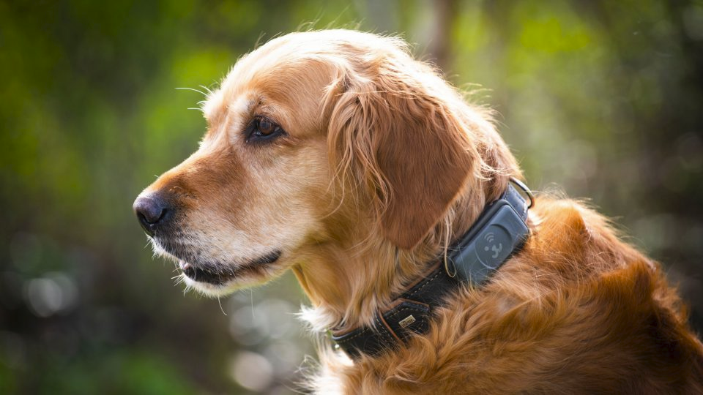
Data-efficient classification of dog owners’
usage habits of IoT devices
Final Presentation
University of Cologne, June 2023

Slide 2
Project Partners
Data & Technology Expert
IoT Startup
Providing data on IoT Smart Devices
Two verticals: Mobility- (E-Bikes) and Pet-tracking (dogs) with more than 300.000 trackers sold (December 2022)
IT project center
Provides Support in
Application Development
IT infrastructure
Data Management and Analytics

Slide 3
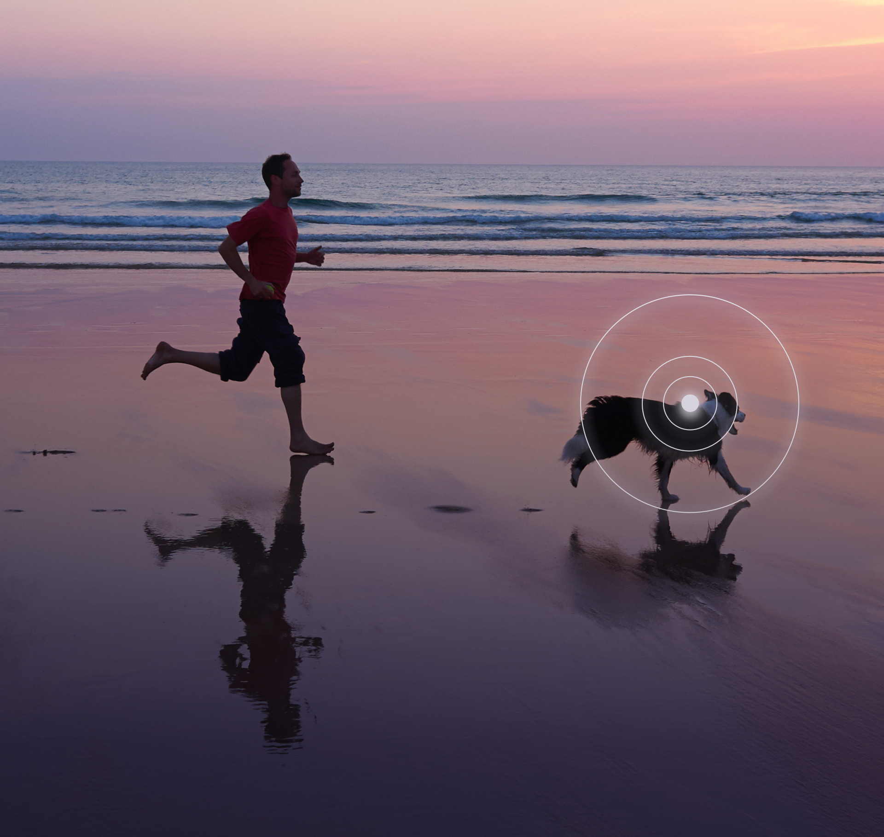
Project Goal
Classify movement patterns with minimal requirements on available data points
Battery optimization strategies
Customer retention strategies

Slide 4
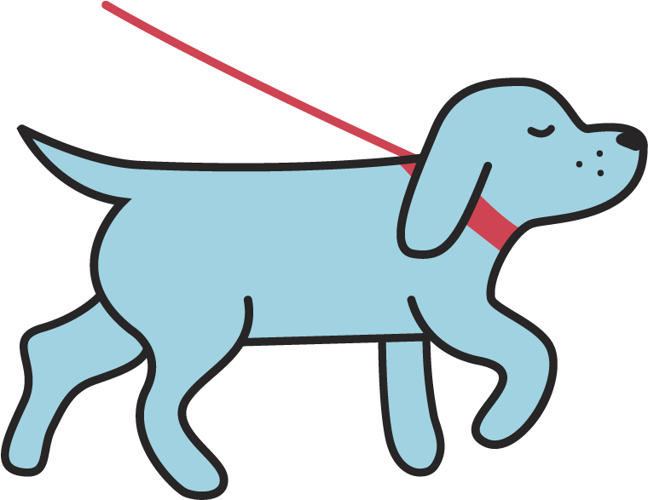
The process
Identifying Ground Truth Labels
Outlook
Data & Features
Final Model
6
Classification

Slide 5
The Data
Created Features
34 Million GPS Data points
Activity
Charging Frequency
Points per Days
Battery Drain
Speed
Walks
1725 devices
Sep 2021 until Feb 2023
! Unlabeled data !

Slide 6
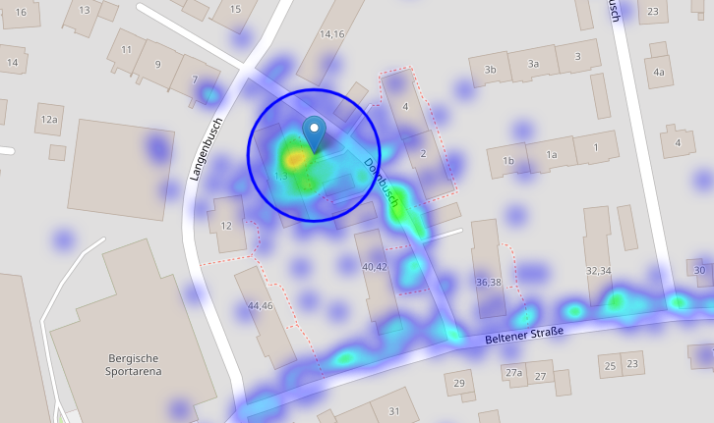
Analysing the Data Points Allows to Identify a Home Location
Highest density of points at night in a radius of 10m
Possibility for a battery saving mode, when the device is “at home”

Slide 7
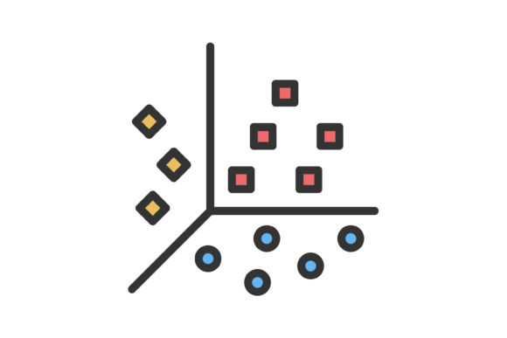
Obtaining Ground Truth Labels
Intensive Users (25%)
K-Means clustering with PCA
Occasional Users (72%)
Outliers (3%)

Slide 8
The Ground Truth Labels
Avg. Points per Day
Avg. daily battery drain (%)
Avg. Speed (km/h)
User Patterns
Total trips
Device counts
Intensive
332
Occasional
933
Outlier
39
Methodology: K-means Clustering with PCA, data from 30 first active days

Slide 9
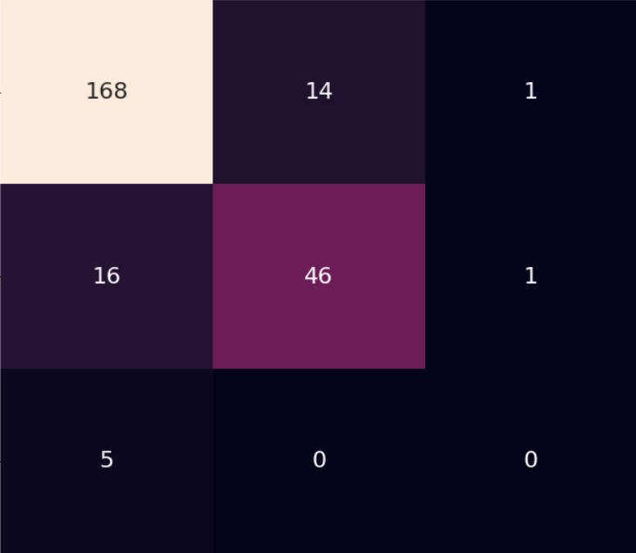
Data Efficient Classification Model
Predicted Values
Random Forest Classifier
86% Accuracy
Training on 1004 devices / Testing on 251 devices
Recall Occasional Users: 91%
Recall Intensive Users: 78%
Recall Outliers: 0%
Occasional Intensive Outliers
Data from first 5 active days of usage
Number of devices
167
13
3
Outliers Intensive Occasional
Actual Values
13
49
1
5

Slide 10
Final Results
With data from just the first 5 active days of device usage, we can correctly identify:
78%
91%
of the Intensive Users
of the Occasional Users
Notes:
I like that, really like “boom” here are my numbers

Slide 11
Recommendations to IoT Venture
Battery Optimization
Customer Retention
Develop battery saving strategy for Intensive Users (i.e. via device settings)
Prediction of inactivity to retain customers before abandoning
Decrease frequency of data points when device is at the home location
Retention of customers by sending notifications when they decrease intensity of usage

